Slide 1
GROUP-11: Vyshnavi Samudrala, Pranamya
Praveen, Adarsh Kumar Rawat
AI-POWERED INSIGHTS: ENHANCING STUDENT ENGAGEMENT AND RETENTION
Date: 09/08/2025

Slide 2
Objective: Use AI and data analytics to improve student engagement & retention.
Scope: Feature engineering, exploratory data analysis (EDA), churn analysis, and recommendation system.
PROJECT OVERVIEW
Tools: Python, Pandas, SQL, Scikit-learn, Power BI/Tableau.

Slide 3
Cleaned dataset: 8,559 rows, 18 columns.
Standardized dates, removed duplicates, normalized demographics.
Created new features: Age of learner, Opportunity duration.
Validated dataset for accuracy, consistency, and outliers.
Week 1 Deliverables (Data Cleaning & Feature Engineering)
Outcome: A reliable data set ready for analysis.

Slide 4
Signups: Growth spikes in Aug 2023 (981) and Jan 2024 (812).
Completions: Very low (0.4% completion rate).
Key Findings:
- 43% applied the same day as signup, but 41.7% rejected.
- 68.2% programs last >1 year → high dropout risk.
Week 2 Deliverables (EDA)
Engagement strongest in 20–25 age group (59.8%).
Insight: Need for better program design, support, and segmentation.

Slide 5
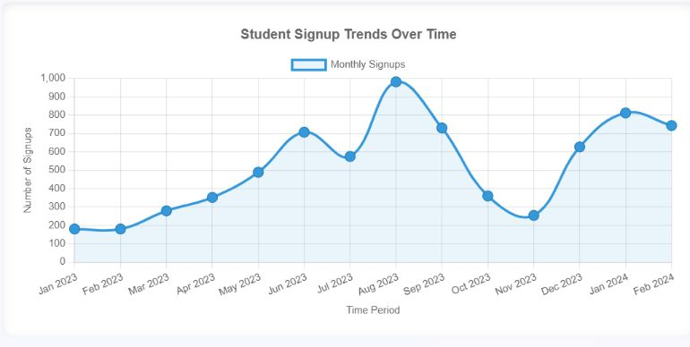
Growth Pattern - Signups grew from 180 (Jan 2023) to 1981 (Aug 2023) with Clear Seasonality

Slide 6
Predictive Modeling: Logistic Regression, Decision Trees, Random Forest.
Top churn indicators: long program duration, delayed start, and demographic gaps.
Model Accuracy: ~79% with Random Forest.
Week 3 Deliverables (Churn Analysis)
Risk Groups: Learners allocated to teams but never started (29% engagement gap).
Insight: AI models can identify at-risk students early.

Slide 7
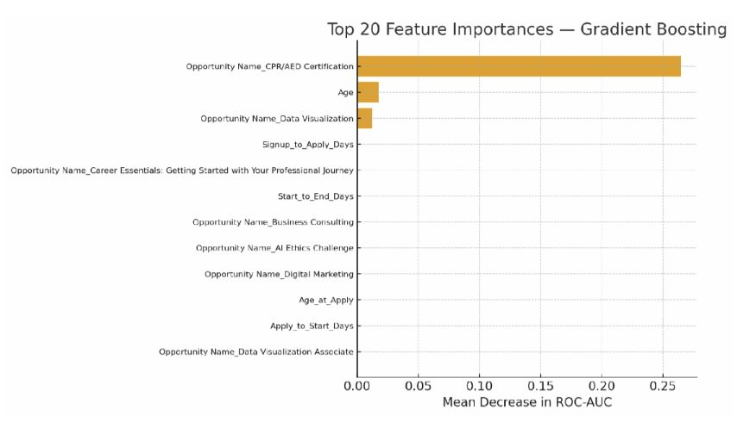

Slide 8




Collected and consolidated raw student engagement datasets
Cleaned missing values using imputation (mean/mode/median)
Removed duplicates and standardized formats (dates, text)
Performed feature engineering (drop-off rate, sign up-to-completion ratio)
Normalized/standardized data for consistent scale
Data Preprocessing

Slide 9
Developed basic recommendation system:
- Content-based filtering: suggests opportunities aligned to prior choices.
- At-risk learner identification: triggers reminders/mentorship.
Week 4 Deliverables (Recommendation System)
Benefits:
- Boost completion rates through personalized support.
- Shorten program duration with milestone tracking.

Slide 10
📌 Target Peak Days: Launch campaigns Thu–Fri (highest signups).
📌 Shorter Modules: Break courses into 30–60 day units.
📌 Follow-Up Mechanisms: Automated reminders, mentor check-ins.
📌 Localized Strategies: US learners (career-focused), India (community-driven).
Key Recommendations
📌 AI Alerts: Predict dropout risk & trigger interventions.

Slide 11
Stronger student engagement = better retention & reputation.
AI-enabled insights help predict and prevent churn.
Next Steps:
- Expand dataset with real-time tracking.
Impact & Future Steps
- Implement advanced recommendation models (collaborative filtering).
- Monitor impact via dashboards (Power BI/Tableau).

Slide 12
Project showed how AI + Data Analytics can:
- Detect engagement gaps.
- Predict student churn.
- Provide actionable recommendations.
Conclusion
📢 Final takeaway: Turning raw data into strategic insights drives long-term program success.

